Slide 1
Statecraft and Classical Liberal Reforms
Professor Nils Karlson, Founder Ratio Institute, Sweden, Visiting Fellow, Stanford University, Hoover Institution
nils.karlson@ratio.se
Notes:
1

Slide 2
The Puzzle …
Great need of liberalization (in the European sense) and welfare-enhancing reform in most countries
Many “big bills left on the sidewalk” (Mancur Olson 1996)
But how can reform be promoted?
Is it possible to formulate a general theory of Modern Statecraft?

Slide 3
Statecraft
The art of governing an advanced democracy and welfare state well
Implementation of welfare-enhancing institutional change = reforms
Most often equivalent to liberal statecraft, i.e., policies that increase liberty and make society more free

Slide 4
A very strong status quo-bias
Special interest and public-goods traps
Negativity biases and ideational traps
Public opinion and preference falsification
Especially difficult in advanced democracies and welfare states

Slide 5
Sweden in the 1970s and -80s The Swedish Model
Extensive transfer systems
Large public sector and bureaucracy
Public production of welfare services
Labor market regulations
Progressive income taxes, high capital taxes, and a very high tax burden

Slide 6
Australia in the 1970s and -80s Australian settlement
1. White Australia
2. Industry protection
3. Wage arbitration
4. State paternalism
5. Imperial benevolence

Slide 7
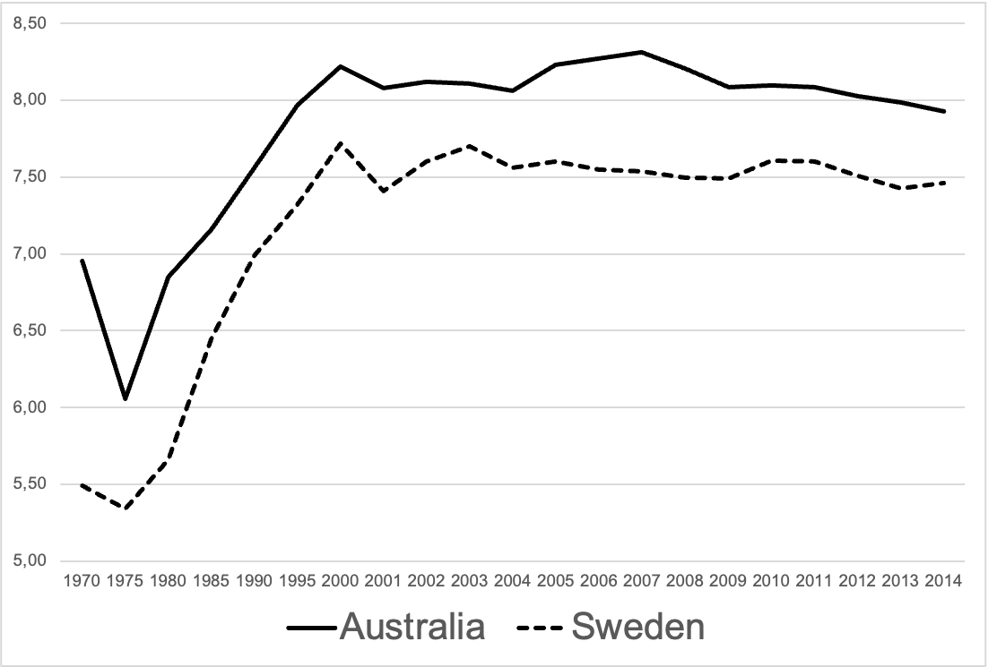
Economic Freedom (Fraser index)
Size of Government
Legal System and Property Rights Protection
Sound Money
Freedom to Trade Internationally
Regulation

Slide 8
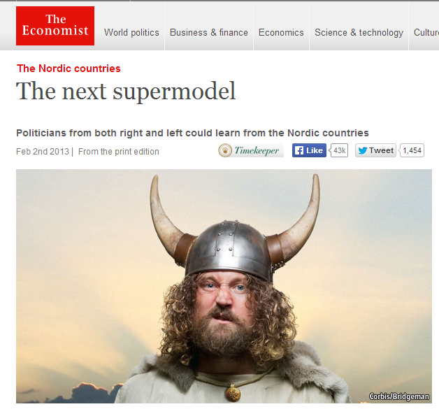
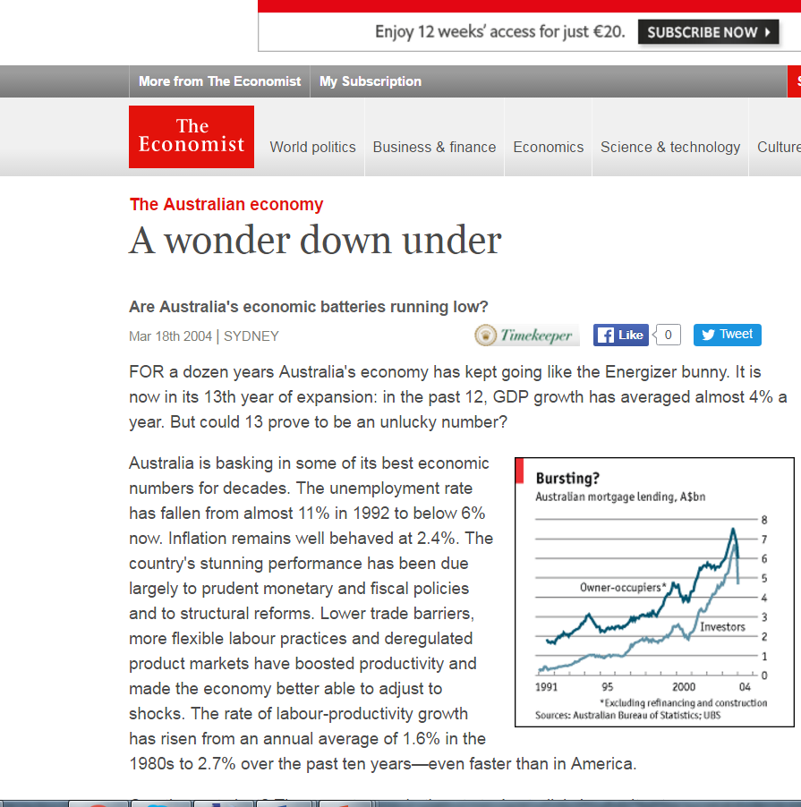
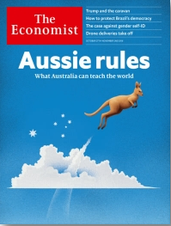

Slide 9
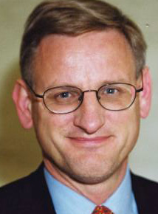
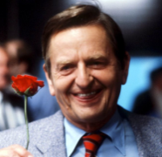
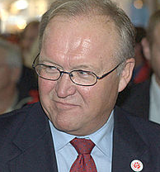
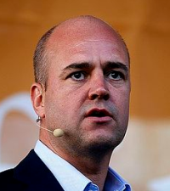
Swedish reforms 1985-2010
1985 Deregulation of credit market
1989 Deregulation of foreign exchange market
1990 Start of deregulation of energy, postal, telephone, railway, airline markets
1991 Agricultural reform
1991 Tax reform, lowering marginal income and capital gains tax rates.
1991 Start of sales of state-owned companies
1992 School voucher system, floating exchange rate
1994 Choice in child care, elderly care, etc
1995 New budgetary process, required surplus over cycle
1995 Less generous social insurance and welfare systems
1995 EU membership
1997 Independent central bank and inflation targeting
1998 Pension reform, balanced
2000 Industrial relations reform
2004 Tax reform, inheritance and gift taxes abolished
-10 Wealth tax abolished, social insurance reforms, labour market reforms, earned income tax credits, tax deductions for household services etc.

Slide 10
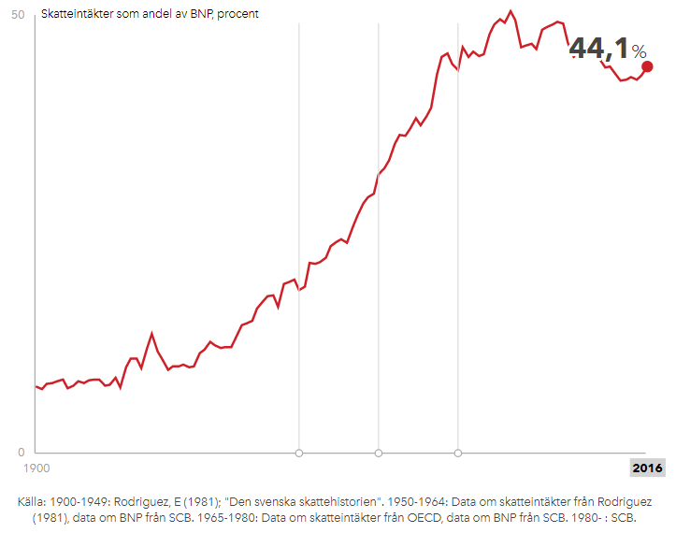
Taxes as share of GDP in Sweden
50,4 %
1990

Slide 11
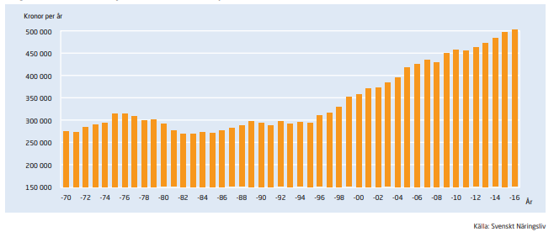
Real wages, white collar (2016 prices)

Slide 12
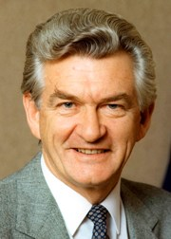
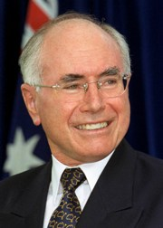
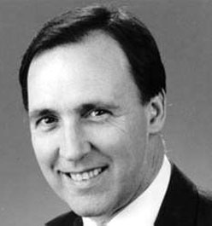
Australian Reforms 1983-2007
1983 Floating of the Australian dollar, abolishing of capital controls
1985 Deregulation financial markets
1985 Tax reform, lowing marginal taxes, abolishing double taxation
1988 Tariff reform starts
1990 Competition, micro-economic reforms, privatizations, deregulation
1990 Firm-level bargaining
1990 Pension reform
1992 Liberalized foreign bank entry, foreign investments eased 1992 Pension reform, superannuation
1993 Industrial Relations Reform, enterprise bargaining
1996 Central bank independence and inflation targeting formalized
1996 Industrial relations reform, Workplace Relations Act
1996 Public sector reforms, competitive tendering, contracting out
1997 Welfare reform, work-for-the-dole scheme
1998 Privatization of employment service
1999 Tax reform, general sales tax
2002 Fiscal consolidation completed
2005-7 Industrial relations reform, WorkChoices

Slide 13
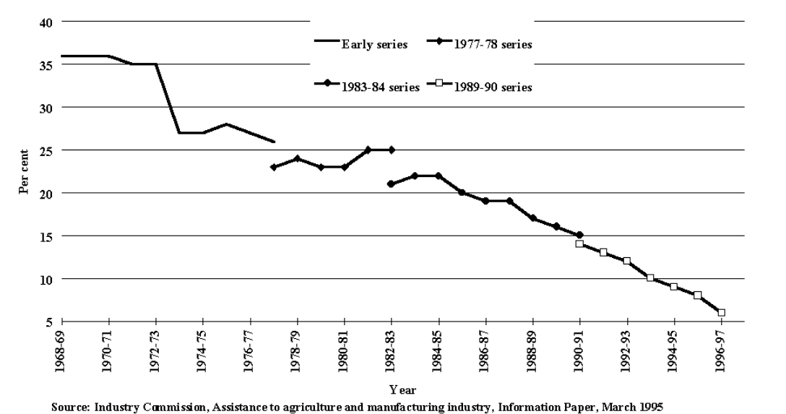
Effective rate of “assistance” to manufacturing in Australia

Slide 14
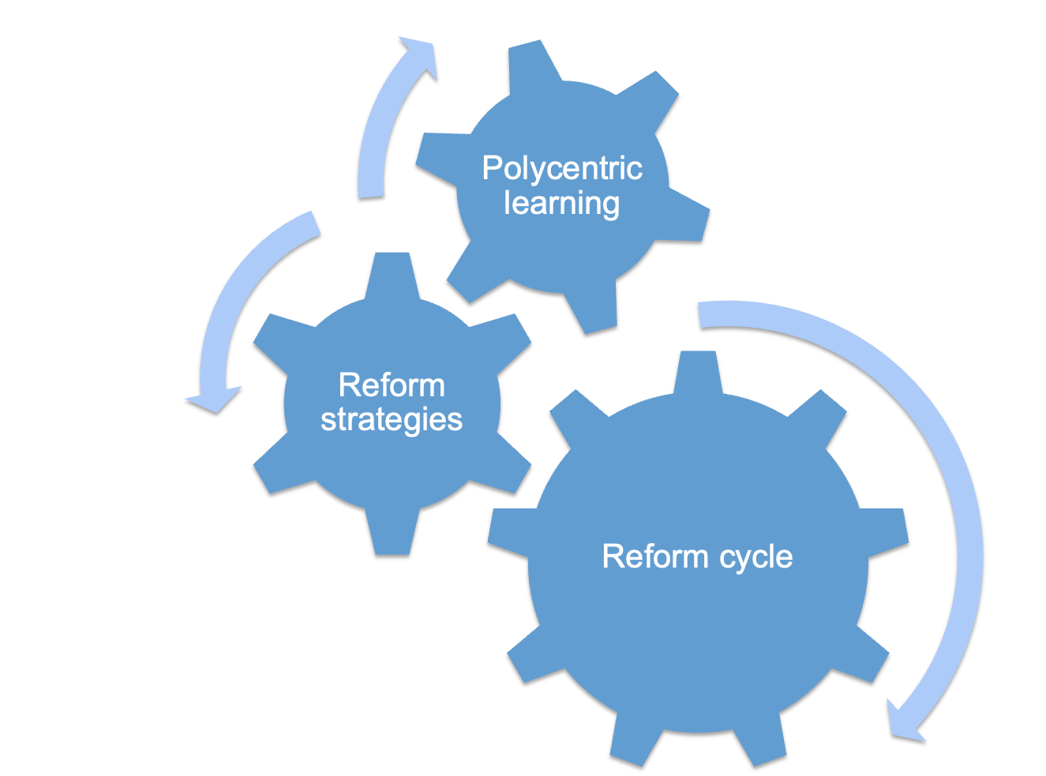
Modern Statecraft

Slide 15
Explaining institutional change
Economic & Social Conditions
Power resources & interests
Institutions & Policies

Slide 16
Explaining institutional change
Ideas, Beliefs &
Values
Policy entrepreneurs
Institutions & Policies (t₁)
Economic & Social Conditions
Power resources & interests
Institutions & Policies (t₂)

Slide 17
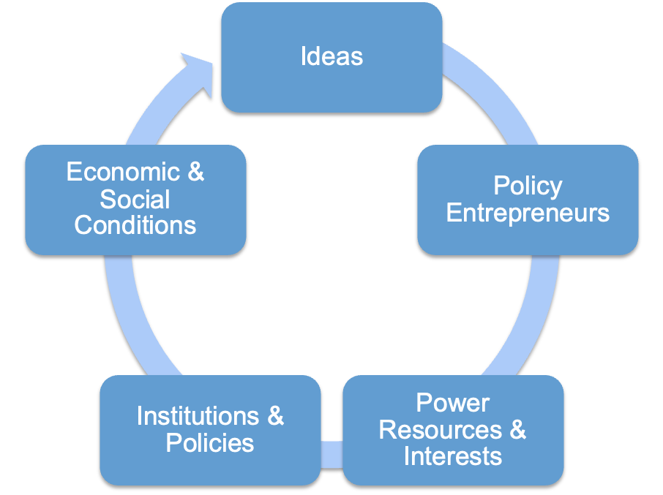
A Synthesis: The Reform Cycle

Slide 18
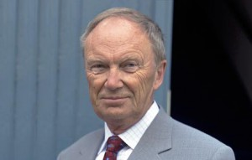
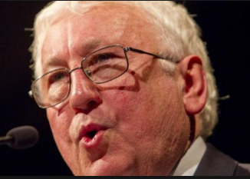
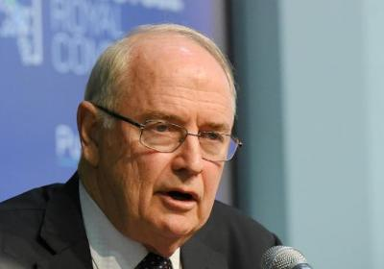
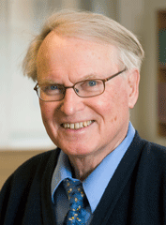
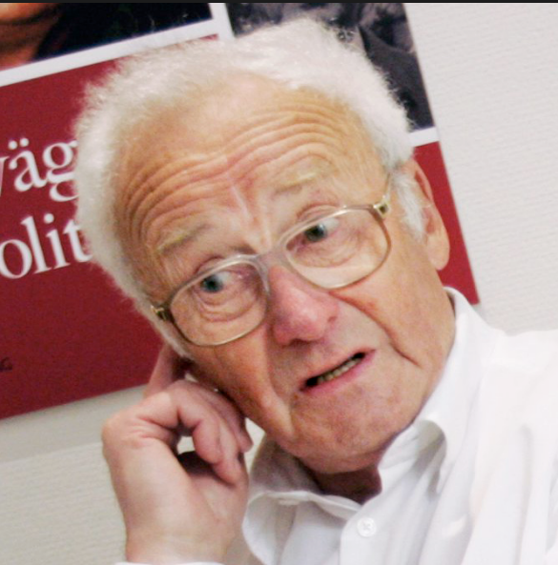
Policy entrepreneurs
Develop and articulate ideas, new facts, new perspectives, values, worldviews to analyze chancing economic and social conditions
Form advocacy policy coalitions
Activate power resources and interests
Influence public opinion, decision makers, bureaucrats etc.
Use different reform strategies

Slide 19
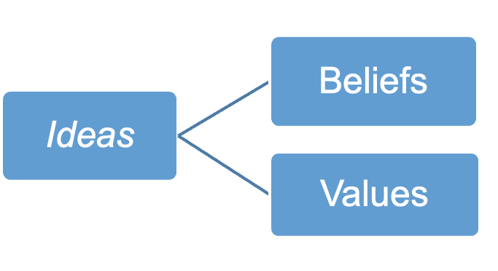
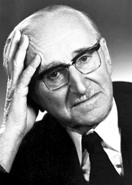
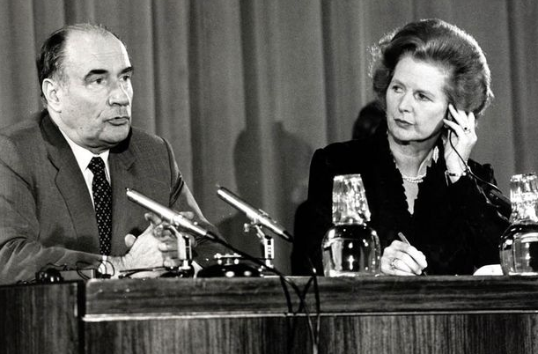
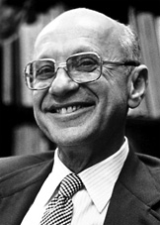
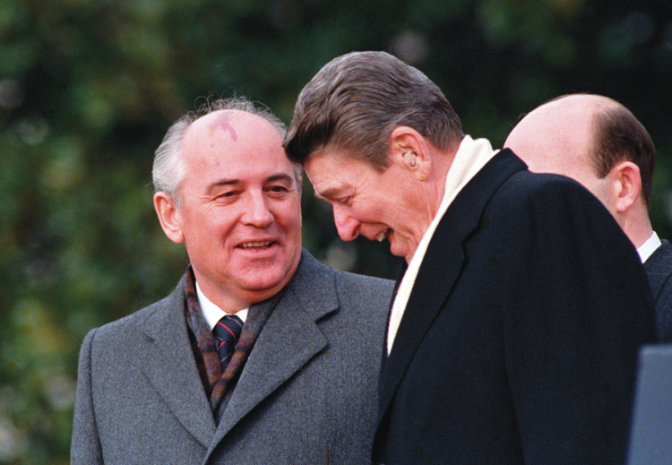
Most important were ideas
Instrument settings
World views/ Policy paradigms
Policy instrument
Overarchinggoals

Slide 20
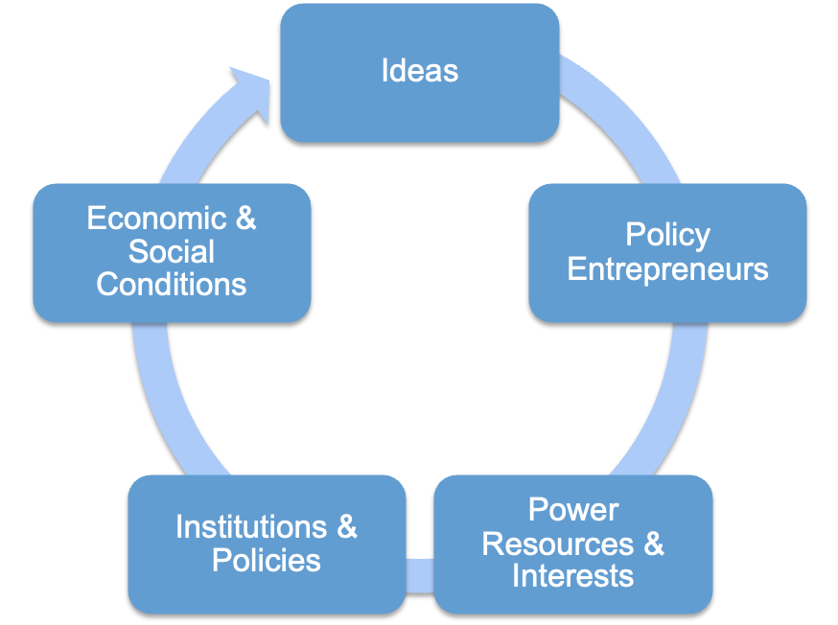
The Reform Cycle
Universities
Examples
OECD, IMF
Individual scholars
Institutes
Central banks
Government departements &
agencies
Voters &
firms
Academics
Technological
changes
Think tanks
Business organisations
Labour unions
Political parties
Party alliances

Slide 21
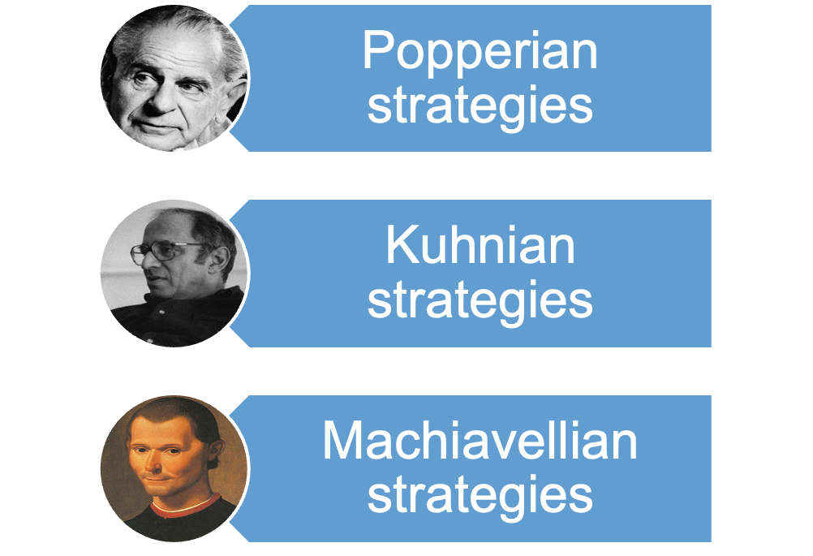
Reform strategies
Reform strategies

Slide 22
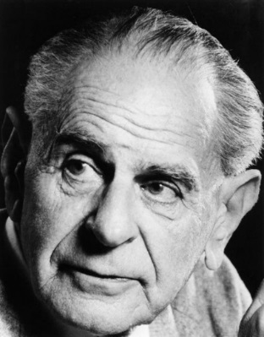
Popperian strategies
Use scientific results, empirical research and experiments!
Rational argumentation and open public discussions.
Incremental, rather than large-scale institutional changes
Do not rely on firm beliefs about how the world works or on strong normative ideals

Slide 23
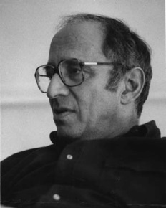
Kuhnian strategies
Use windows of opportunities, focusing events, crises or critical junctures!
Focus on policy failures, really striking facts and figures, and examples
Use narratives and rhetoric to frame and redefine discussions and agendas
Paradigmatic shifts are long-term projects – easier to change beliefs than values and preferences

Slide 24
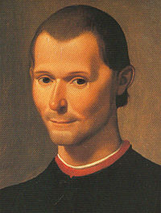
Machiavellian strategies
Obfuscate and lower the visibility through masking, indexing, delaying consequences etc!
Split the opposition and play off one group against another, compensate some and not others
Do not show your real intention, spread the blame for hardship on others
Beware that your competitors and partners use similar strategies

Slide 25
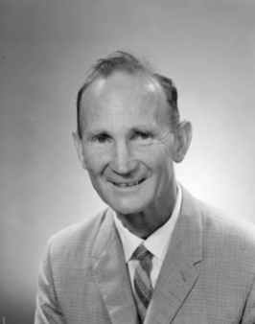
Example: The Australian tariff cuts
Alf Rattigan, long term chair of the Tariff Board became an anti-protectionism policy entrepreneur
Supported by the Crossroad group and other academic policy entrepreneurs
Implemented by the Labor government through successive corporatist Accords with ACTU, circumventing the cabinet and ministries
Pro-consumer perspective, simultaneous changes in taxes, pensions etc.
All reform strategies used

Slide 26
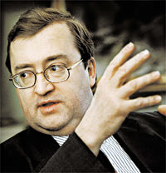
Example The Swedish tax reform 1991
Initiated by the Liberal Party – and heavily criticized by the Social Democrats
Later implemented by the same parties – everyone else opposed the reform
Very ambitious – lowering marginal income and capital gains taxes, broadening the tax base etc.
Economists at Ministry of Finance key policy entrepreneurs
Many simultaneous changes made it hard determine winners and losers
All reform strategies used, but Machiavellian dominated

Slide 27
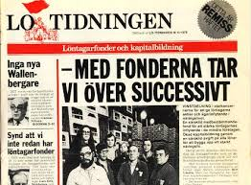
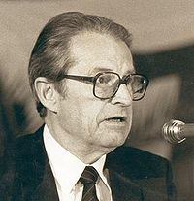
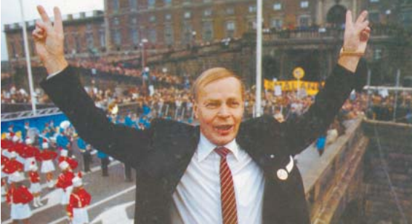
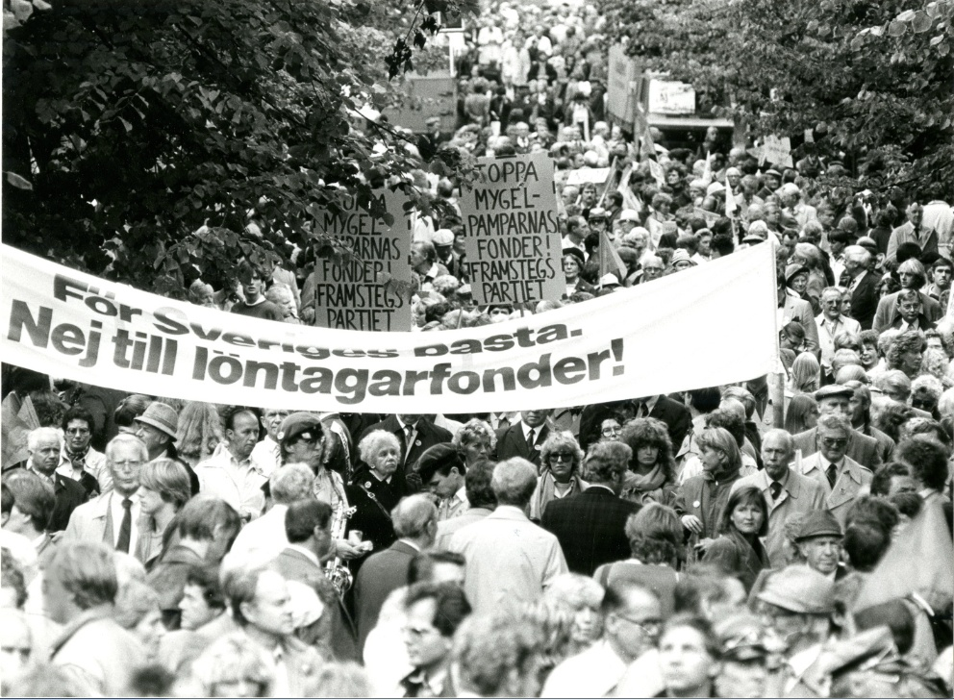
Example The Swedish wage-earners funds
Attempt to massively socialize private industry by Social Democrats & LO 1975 -
Leading CEO Curt Nicolin made chairman of Confederation of Swedish Enterprise 1976-1984 – strong idea focus
Massive pro-market campaigns, cultivation of non-socialist parties and academics
New policy entrepreneurs: think tanks and publishing houses, private radio station etc.
Mobilization of members and large-scale demonstrations 1983
Wage-earners funds finally abolished 1992
Combined Popperian and Kuhnian strategies

Slide 28
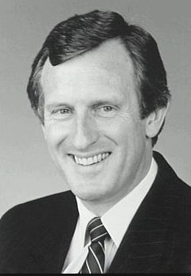
Example Australian attempts to shift the policy paradigm 1991-1993
“Fightback” proposal by Liberal Party leader John Hewson, radical market-liberal reform agenda and the GTS
Keating’s “New Australian Policy” with a new narrative, multiculturalism, pro-Asia, cutting ties with British Crown
Both failed due to bad reform strategies
Too radical for middle class voters

Slide 29
Results of the case studies
The reform cycle fits the empirical evidence very well in both Sweden an Australia – ideas and policy entrepreneurs crucial
All three reform strategies also important, not the least Machiavellian strategies. But idea-based Kuhnian strategies perhaps most important
Modern statecraft requires a combination of knowing what and knowing how

Slide 30
Remaining puzzles
Why not welfare-decreasing, illiberal institutional changes instead?
How was the collective-action problem involved in liberal reforms solved?

Slide 31
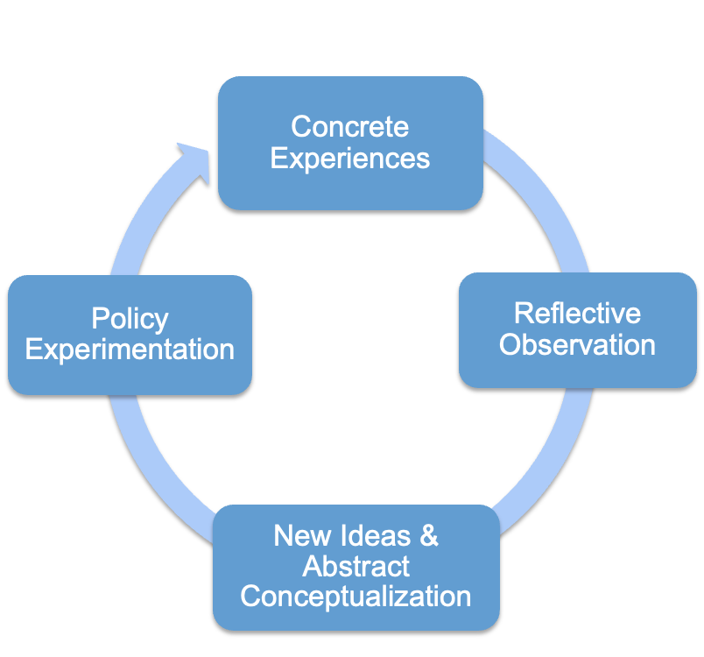
Polycentric experiential learning important
Polycentric learning
Many policy ideas were developed in the reform process itself
Took place in the central zone – many actors involved
Largely top down
Hard-won reforms were often kept by opponents
Analytical skills where crucial in this
Central Zone

Slide 32
Modern statecraft
The art of governing well by implementing welfare-enhancing, liberal reforms
Requires both analytical and political skills
Takes place within the reform cycle, where Popperian, Kuhnian, and Machiavellian reform strategies are used
Requires a polycentric effort of experiential leaning, in the central zone of a country

Slide 33
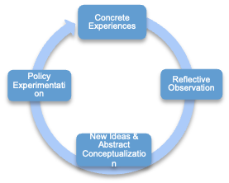
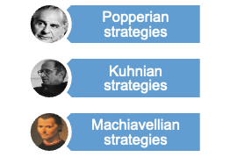
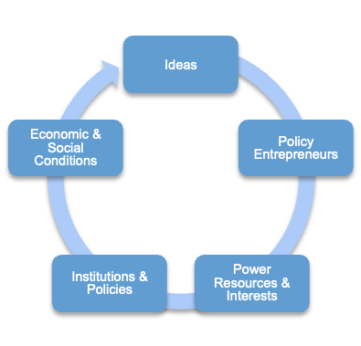
Modern Statecraft
Central Zone

Slide 34
Summary To promote classical liberal reforms
Analyse the economic and social conditions
Conquer the idea arena
Promote policy entrepreneurs
Form advocacy coalitions
Invest power resources
Use all reform strategies
It is a long-run project with great potential!

