Slide 1
European Energy Insights
EUROPEAN TRIP
Oct 2022
Peter Iancov
Peter Iancov
3-7 October 2022

Slide 2

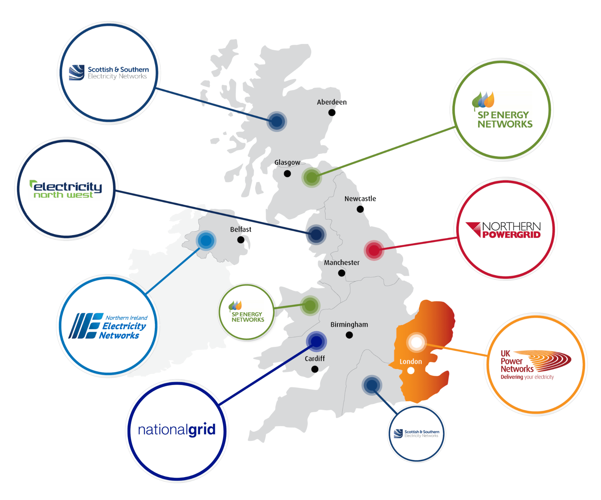
  29% of Great Britain Electricity Distribution
  £1.8 billion annual revenue
  8.3M customers 5,500 employees
  14 GW peak demand
  190,000 km power lines
  8.4 GW Distributed Generation
  Network prices account for 16% of total electricity bill

Slide 3
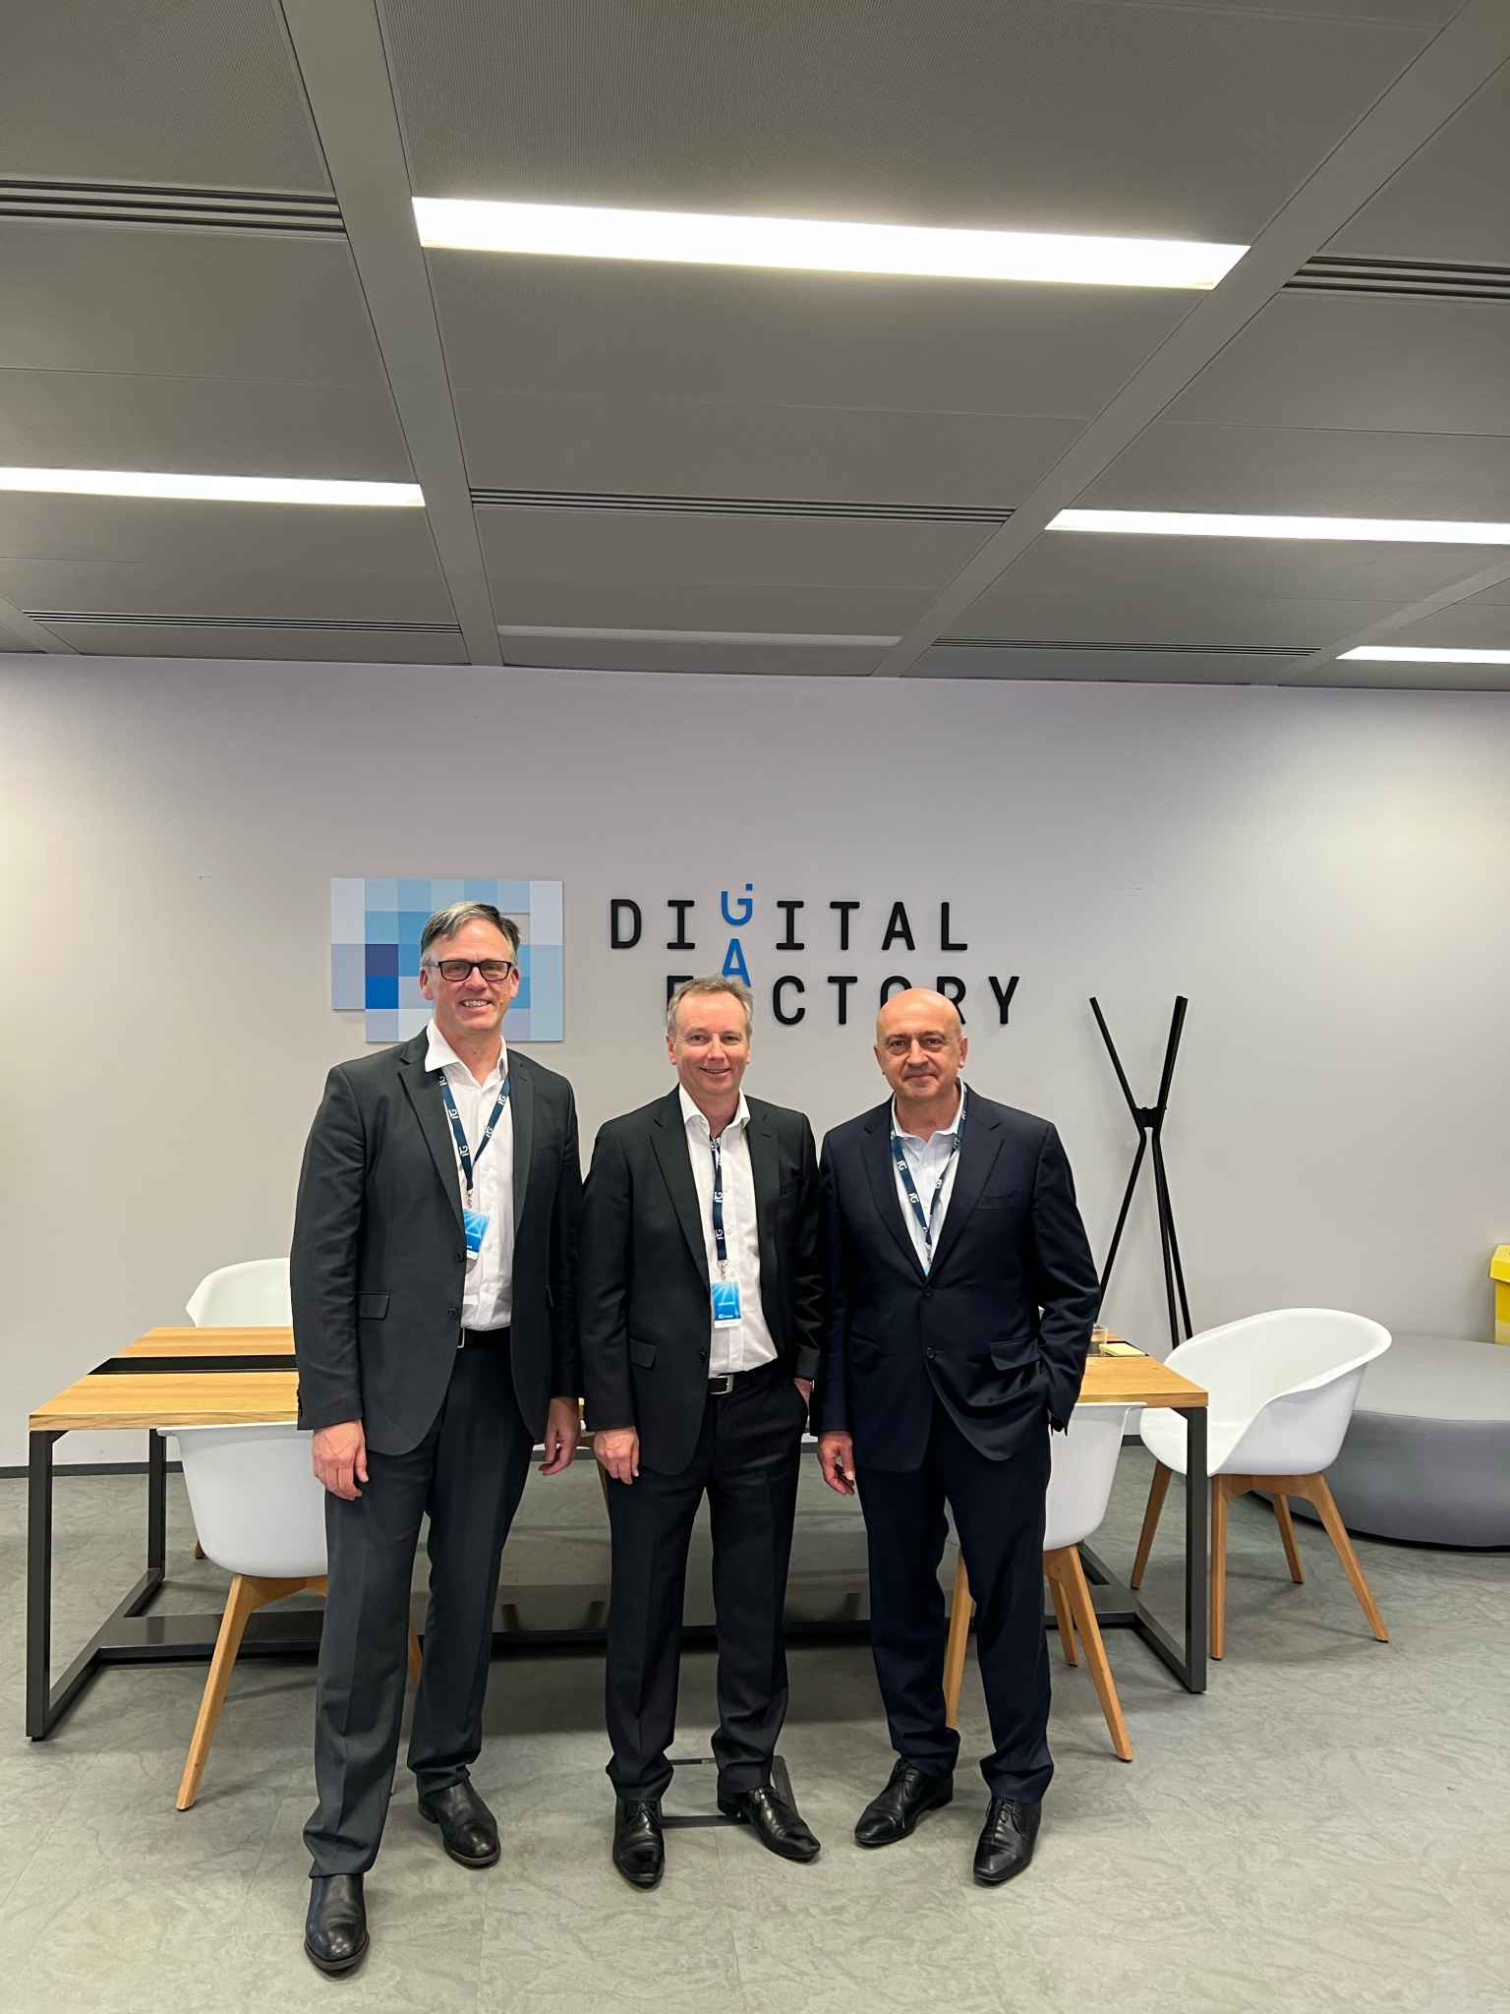

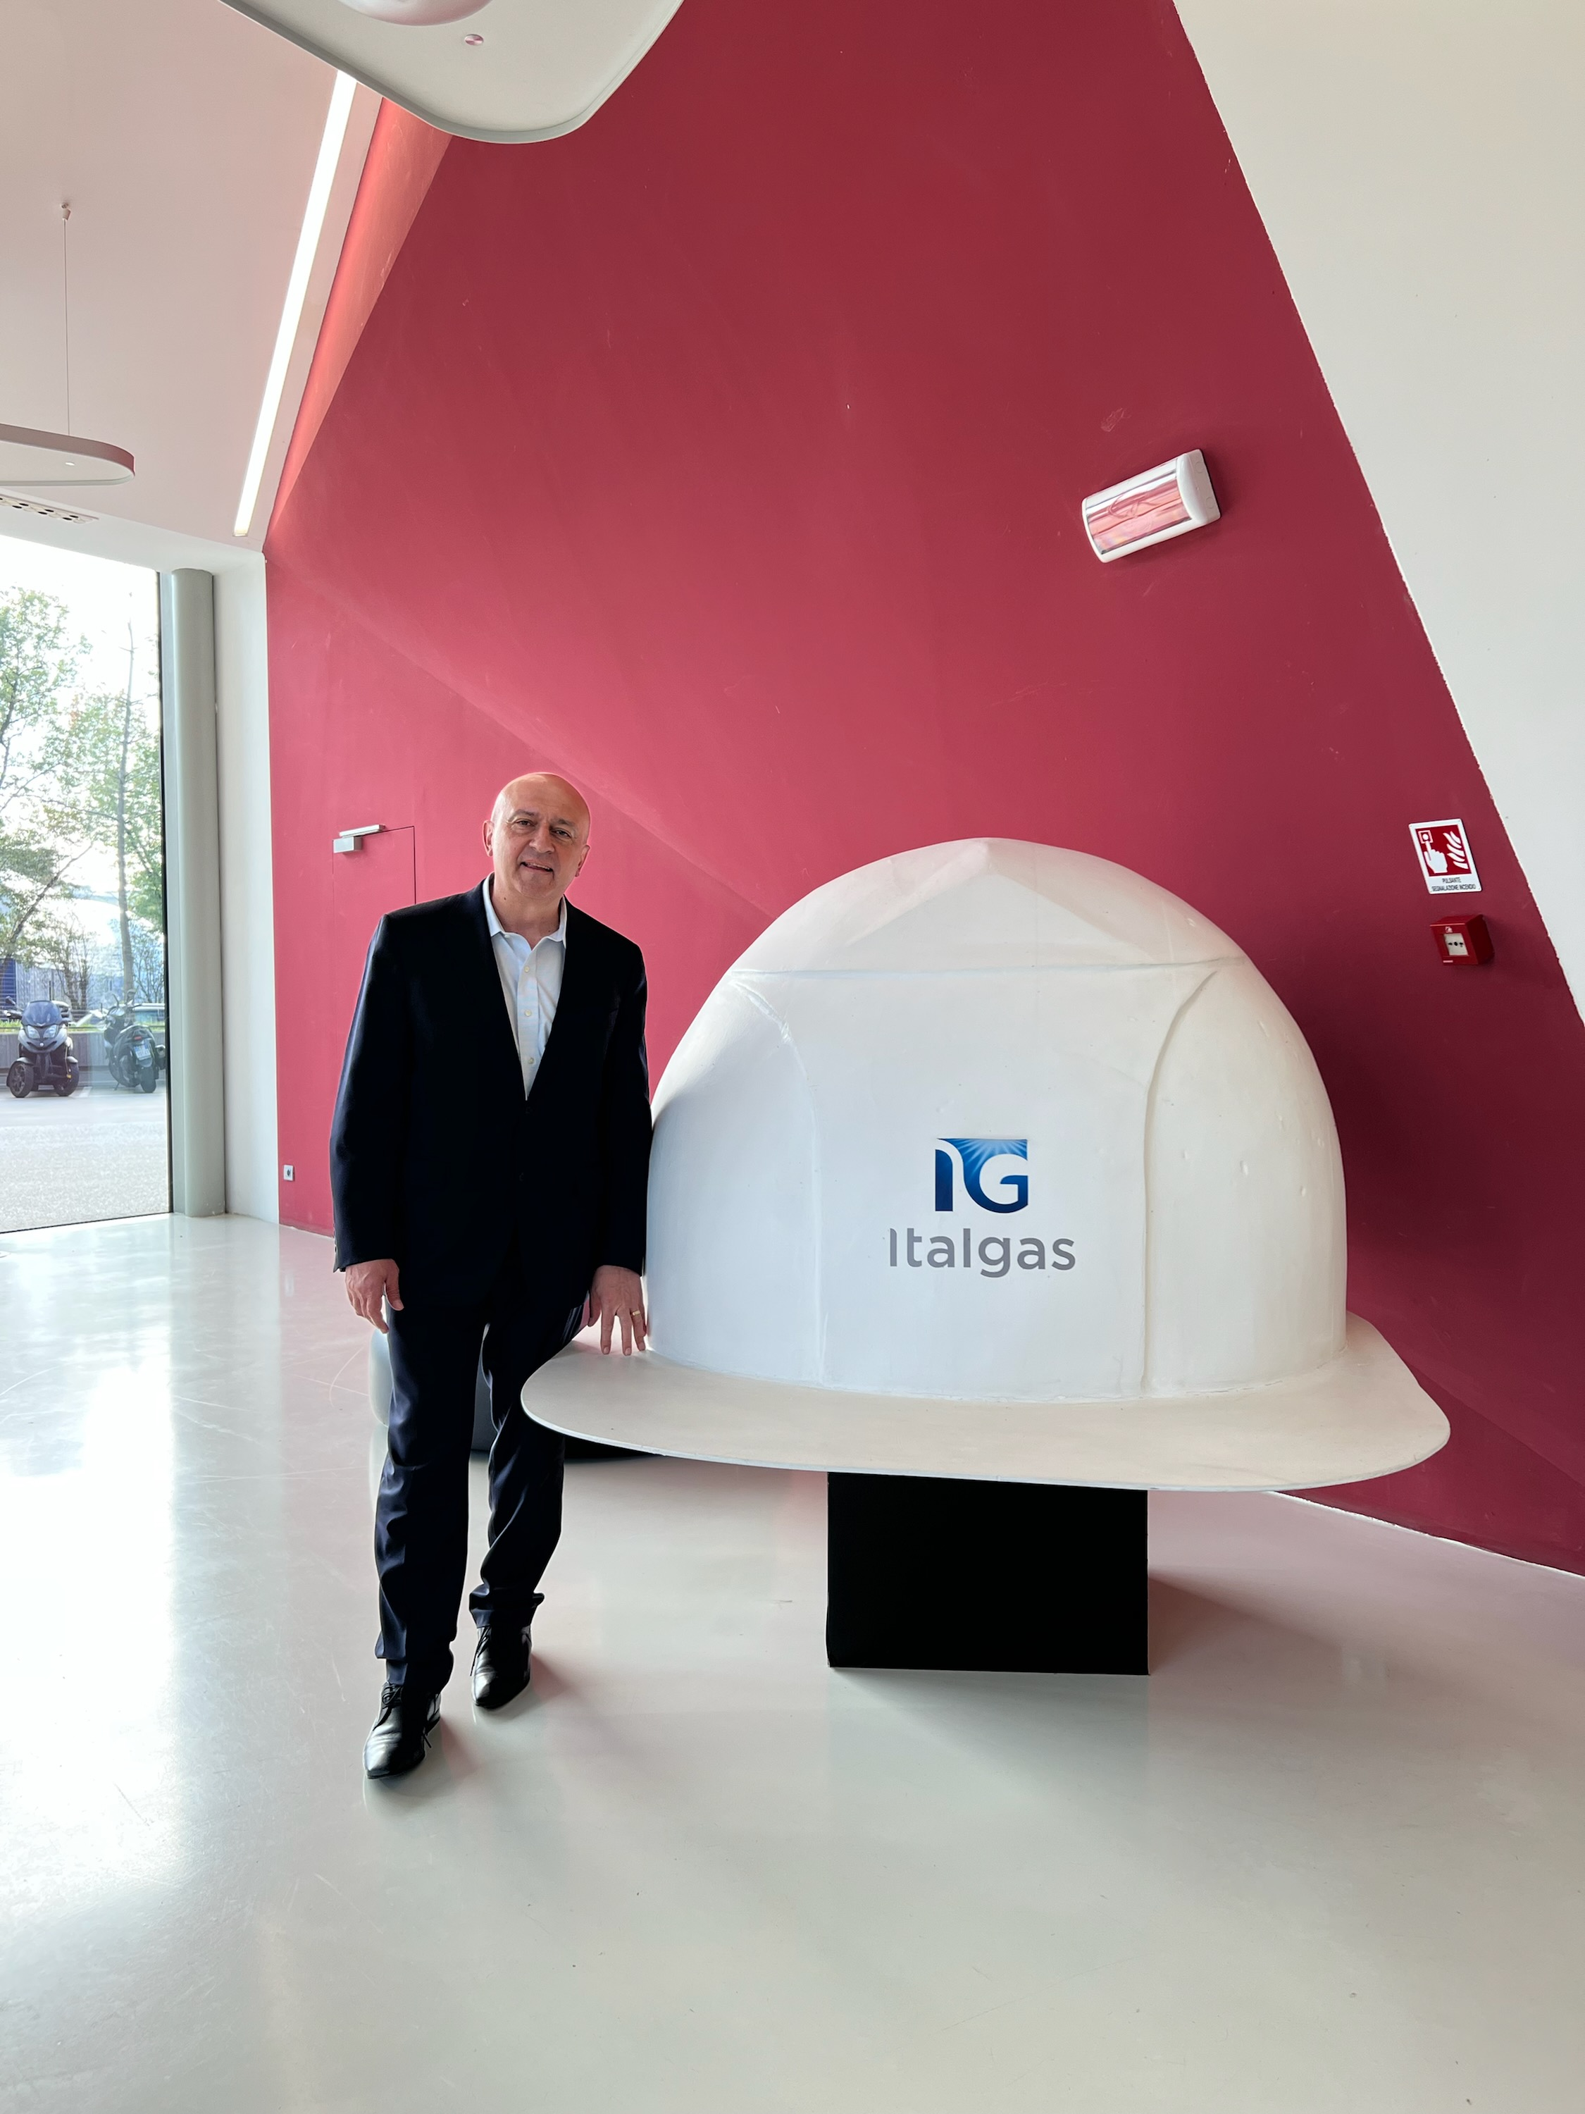
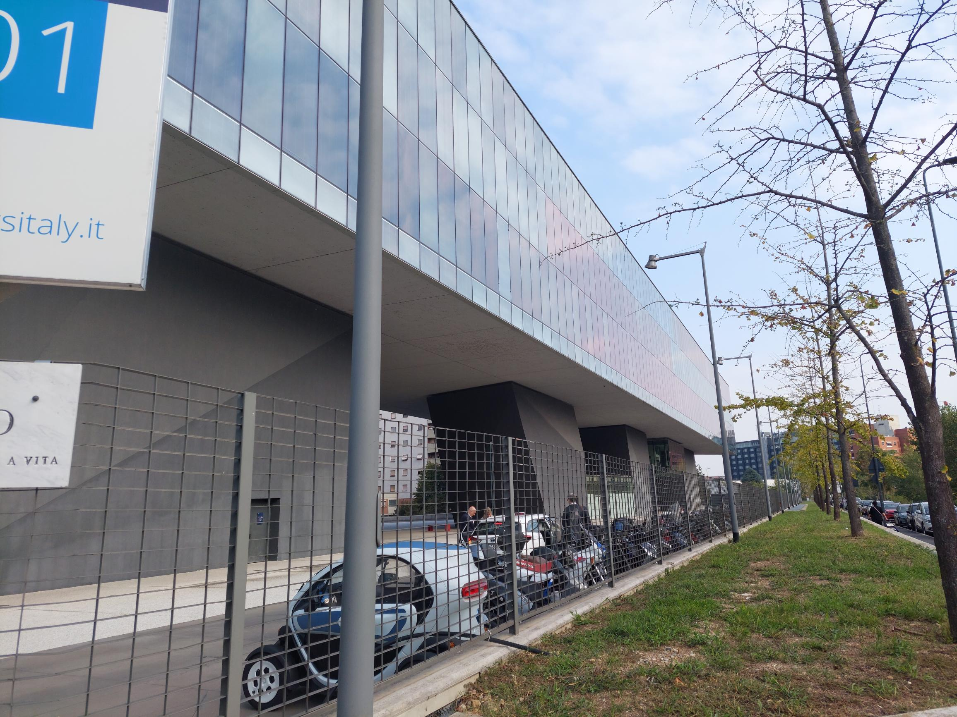
  35% of Italy’s gas distribution
  €1.3 ($2b) billion revenue
  RAB value €7.8B ($12B) – about 2.5 times SGSPAA
  4,000 employees
  8.6 Million gas distribution customers
  7.8 Million Gas Smart Meters
  74,400 km of Pipe ( NSW has roughly 25,000km)
  92% of all households use Gas in Italy

Slide 4
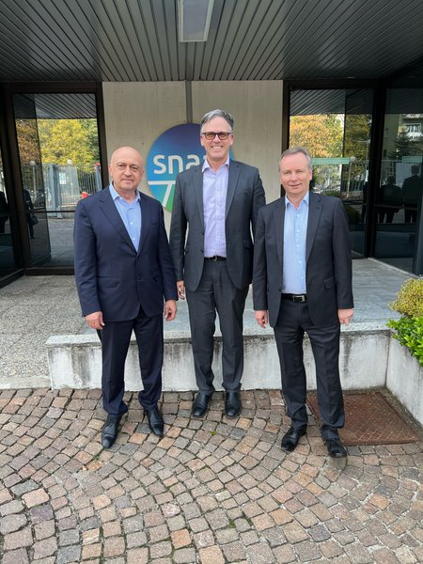

  Gas Transmission, almost 100% of Italy
  € 3.3B Revenue
  €24B RAB, €31B enterprise value
  CDP (Govt) own 30%, 70% public
  3400 employees
  2850 PJ pa (5x Australia domestic use)

Slide 5

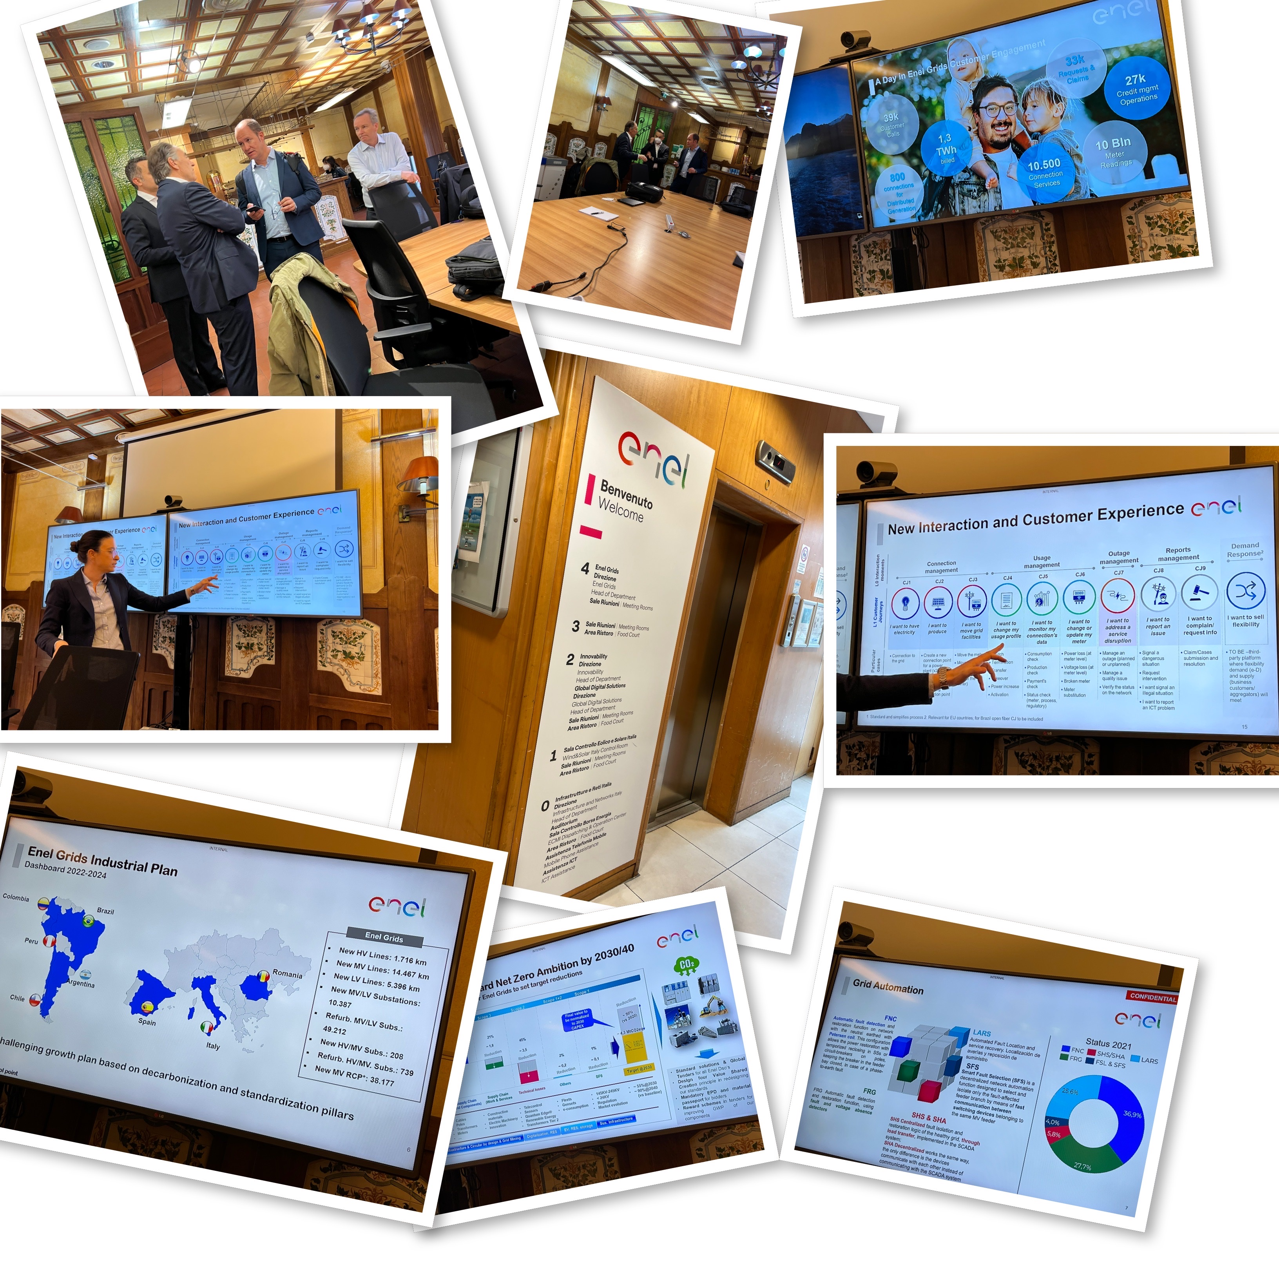
  Grid company present in 8 countries across Europe and South America
  € 31Bn revenue
  66,000 employees (50% elec distribution)
  75M customers
    European customers are Elec Distribution only
    South America – Retail, Distribution & Generation
  45M smart meters deployed
  500TWh pa (Australian 200TWh)

Slide 6
Key Themes
Customer Service
Future of Gas
Digitisation
Future Grid
So What ?

Slide 7
Customer Service is a top level priority
  Customer Satisfaction is a headline KPI driving whole of business performance
  Improvement journey driven by customer research, customer mindset, and disciplined management with data-driven scorecards
  Disciplined management of end-to-end customer journey changes
  Digitisation at core of business improvement program
  Dedicated focus on customer vulnerability
  Key to success is a common focus across the entire business

Slide 9
Customer Service is a top level priority
UKPN
Enel
  7 key customer principles that guide the entire business
    brilliant service / decarbonisation / safe, reliable and resilient network / lowest possible bills / good in the community/ employer of choice / worthy of your trust
  Measures
    CSAT, Complaints, Vulnerability, Stakeholder Engagement
  CSAT (= connections +, outages + general inquiries journeys)
    Metric and data driven - polls 100,000 customers pa
    Track 5 performance dimensions – service experience, complaint handling, Customer ethos (I do what I say), emotional connection, Ethics (I trust you)
    Compare to best across all industries (not just energy) #1 in UK (94%)
    Very disciplined approach to customer journey changes
  Complaints
    Resolution time 1.5 days average, 14 complaints per 100,000 customers
  Consumer Vulnerability – lifting support during ED2 Reg period
    Priority services register (Life support), increase from 2.2M to 3M
    Fuel poverty (1.3M) increasing support service from 25,000 pa to 100,000 pa – energy efficiency, access to grants
    Disadvantaged from participating in transition (eg renting, no rooftop). Increase support from 250 pa to 100,000 pa
  Regulatory Incentives (ED2)
    UKPN invests £20M for £30M max incentive benefit
  Global model for CSAT measurement
  Disciplined focus on end-to-end process
  Digital innovations in practice
    Virtual Visit
    Daily dashboard reporting
    Automated next best actions
    Real-time connection quotes
UKPN Digital use cases for customer
  Improving C-SAT by predicting low scoring jobs and intervening earlier
  Estimated Restoration Time predictor
  Connection Small Services budget estimator
  Low voltage network utilisation predictor

Slide 10
Future of Gas narrative is more positive than Australia
  Gas is seen as fundamental to the long-term energy system
  Hydrogen transmission backbone planned for Europe but over time
  Biomethane is more mature and a decarbonisation solution together with nuclear
  Carbon Capture and Storage seen as a component of the solution
  Residential/commercial heating by Hydrogen remains uncertain
  Mature engineering development of H2 distribution readiness it will take years

Slide 11
Future of Gas narrative is more positive than Australia
SNAM
Italgas
  Very confident on the future of gas.
    Not enough renewable electricity and storage possible
  Gas generation will be critical to future electricity supply
  Biomethane is a mature industry and growing (~12% by 2030)
  Cautious outlook on hydrogen – a long way to go, and may not suit all customers – likely for hard-to-electrify industrial loads
  13% energy efficiency of gas system by 2030
  No detailed plans post 2030
  Hydrogen transmission backbone interconnect planned for continental Europe
    €40-80b investment
    70% repurposed, 30% new pipelines
  Biomethane is mature and growing in Italy
  Carbon capture and storage is a key plank of net zero strategy
  Elegant strategic response for SNAM Gas Transmission.
    3 existing looped parallel natural gas transmission pipelines to be redeployed as:
      Methane & biomethane
      Hydrogen
      Carbon capture
  Italy’s crisis response to replace Russian gas which was 29/75 BCM involved 2 new import terminals being developed (+3 = 5)
  Mature engineering development of H2 readiness
    New technical standards developed for 100% H2
    SNAM can offer engineering services and testing for end-users, 10%-20% blending + 100%
UK
  Believe gas will be required in the UK through to 2050, but hydrogen may not be right for residential customers
  Hydrogen towns developed as pilots
  Heating strategy decision by Govt planned for 2025
  Ambition of 10GW H2 (300PJ/a or ~10%) by 2030 – will require Govt leadership
  Gas Distribution ring-fenced from investing in hydrogen generation
  Biogas potential is quite small (~5-10%)
  No new gas boilers in new build from 2025

Slide 12
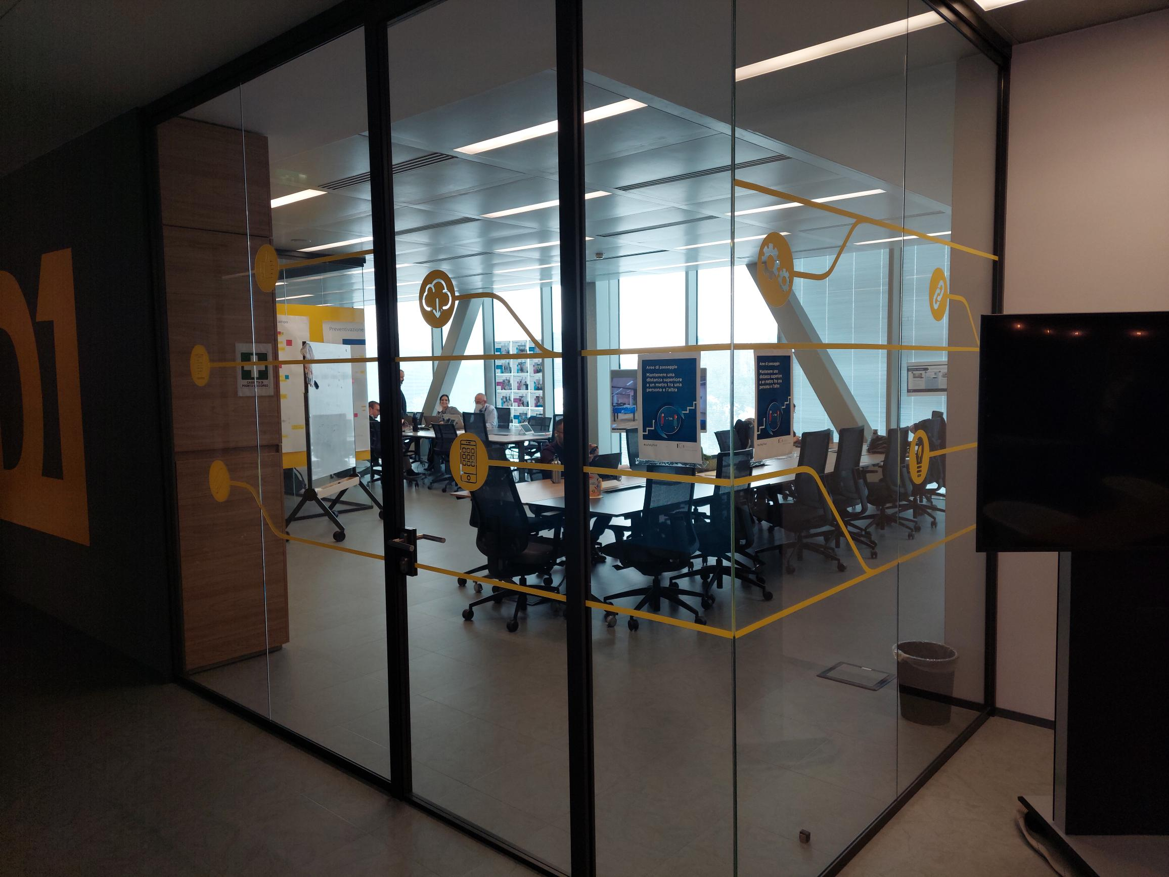
Accelerating Digitisation is a large opportunity
  ItalGas Digital Transformation is built on:
    Domains: Asset/IOT, Process Digitisation and People/Org agilisation
    Enablers: Cloud, IOT/Data and Digital Factory
  Digital Factory showcases outcomes from agile development
    6 work streams in parallel across multiple themes (customer, field, asset, employee)
    Each cycle delivers MVP in 4 months
    Extensive leverage of data analytics
  ItalGas extensive investment in smart meters
  and IoT sensors / control for gas network

Slide 13
Accelerating Digitisation is a large opportunity
Italgas
UKPN
  Core technology behind Jemena in terms of core platforms
  Have progressed with Smart Grid but low on smart meters
  Limited Agile techniques/development to date but plans to expand
  Data and analytics expertise - prioritised for financial and CSAT
    Interesting use cases underway
      CSAT score predictor, estimated restoration time, LV network visibility, vegetation management, cable route design, connection estimate, procurement optimisation
  Strong belief in Agile/Digital
    All systems (inc SCADA on cloud)
    Huge investment in Digitising (via IoT) the Gas Network
    Big investment (Mgt and $$) made in the Digital Factory
  Digital Transformation is explained by a “3 by 3”
    Asset/IOT, Process Digitisation and People/Org agilisation
    Enablers Cloud, IOT/Data and Digital Factory
  Digital Factory set up in 2018 to break down Silo related behaviour
    9 core staff from ItalGas and McKinsey
    Delivery managers and UX designers are core
    6 purpose built rooms to support co location of cross functional team
    Each room has a purpose/name which may change over time
  All activities in these rooms are run agile and very strict methodology
  Constrained to deliver MVP within 4 months
  Discovery 4-6 weeks, agile sprint 10-12 weeks
  Sprint reviews every 2 weeks with exec sponsor, monthly with CEO
  End of each MVP group does a video to communicate out.
  Business resource are dedicated and have to come to site in
  Best people, backfilled and funded
Italgas
  Number of Software Demos shown:
  DANA ( Digital Analytics Network Analysis). Custom developed Gas SCADA system with extensive real time monitoring support by wide deployment of IoT
  Work on site App. Allows photos to calibrate depth of trenches
  Click to Gas – connections portal
  Analytics predictive model to forecast smart meter failures
  CapexForce console for investment planning - end to end focus
Enel
  Digital innovations in practice
    Virtual Visit
    Daily dashboard reporting
    Automated next best actions
    Real-time connection quotes

Slide 14
Investment in Electricity Future Grid drives value
  Extensive investment in grid automation and digitisation to drive business value, net zero and customer outcomes
  Enel electricity networks expertise we can learn from
    Multiple use cases deployed at scale
  Distribution System Operator (DSO) role taking shape
    DSO focus is enabling acceleration of NetZero transition
    UK considering separation of DSO and DNO (Network) roles

Slide 15
Investment in Electricity Future Grid drives value
Enel
DSO Role development
  DSO Purpose is to enable Net Zero transition
    Prioritising ‘flexibility services’ (non-frequency ancillary services, ie DER, embedded generation) ahead of network augmentation
    Flexibility services procured via a market-based approach
  Energy balanced on Distribution grid Digital in real-time
  Manage congestion and voltage regulation
  Co-ordinate new energy stakeholders
  UKPN - leading UK thinkers on role of DSO/DNO
    Setting up separate legal entity and board for DSO
    DNO future focus on Lights On + Reliability
    DSO deliver capacity to support Net Zero at minimum customer cost
  DSO Role. 1) Planning & network development, 2) Network operations, 3) Market Development
  Key focus is Local Area Energy Planning (LAEP)
    Work with Councils on their non-network / embedded generation plans.
  Extensive grid automation and digitisation to drive business value, net zero and customer outcomes, eg
  HV automation and self-healing
  LV monitoring & load flow analysis
  Digital Twin and vegetation management
  3D viewer for field, Workforce AR training,
  Remote assistance, NetNav, Documents
  Demonstrated expertise on their electricity networks that we can learn from - Open Power Grids Community is a sharing platform of Enel technical strategies
Increasing predictive maintenance via analytics and condition monitoring
Investment for increasing grid hosting capacity for DER
  Advanced voltage regulation via DERMS
Resilience focus to respond to Climate change impacts (snow-cable icing, windstorm, heatwaves)
Influencing equipment manufacturing to minimise CO2 footprint

Slide 16
Key learnings ->
Actions ….
  Europe/UK capture significant value and are well ahead of Australia/Jemena on network automation and digitisation
  Well progressed with DSO readiness demonstrating advanced maturity with clear models in mind
  Future of Gas is highly dependent on Govt leadership. The jury is out on H2 for residential usage - biomethane is a stronger near-term option
  Digital is a massive value driver - we have a strong Digital base in cloud and platforms, but can drive much more business value through elevating our agile capacity and capability and analytics utilisation
  Single-focus businesses (ED, GD, GT) build strong alignment and excellence amongst teams. Operational management discipline and standardisation creates value (customer, financial, safety outcomes)
  Other regulatory jurisdictions provide more freedom and incentive for innovation and responding to the changing market than Australia
  Review our future grid plans against European practice and ideate Gas Distribution / Pipelines opportunities
  Develop a clear house view on our DSO model
  Inject Italy/Europe renewable gas development plans for local advocacy and customer engagement
  Formalise and expand our Digital rooms (eg CX, Field scheduling & mobility, Smart Grid)
  Develop cross-functional forums to drive performance
  Build innovation strategies for coming reglatory processes

Slide 17
Other notes
  Safety (people, assets, public) important however not discussed a lot. It is seem as a given and discussed at operational level only.
  Relationship with the Regulators, Government and Customers is a lot better in UK, Italy and seemingly across EU than in Australia. Working together and allowing investment to flow into RAB if solving customer problems.
  Electrification is seen as a path towards Net Zero Emissions but not taken as the only solution. No more than 55% of current ‘other fuels’ (gas, LNG, LPG, Diesel) will likely be electrified (SNAM, Italgas). The EU Commission for Energy is not assuming more than 55% being electrified. There is some debate if the percentage is 45% of 65% but no one believes that 100% is possible with current technology.
  Residential electrification likely easy, mobility not that straight forward and it will take time; heavy industry electrification unlikely to happen fast or at all (SNAM).
  Hydrogen not seen as a near term solution.
  Customer (external and internal) at the centre of all decisions and innovation initiatives.
  Priority of investment seems to be energy transition, network reliability, customer, safety and environment and resilience (and in that order). (ENEL)
  Insourcing / outsourcing is a mixed strategy and dependent on geography, commercial / financial benefits and local culture. No template applied. (ENEL). Using large / long term partnerships (UKPN).
  Standardisation applied to design and specifications across all grids and across multiple countries in a some order (grid components supply chain (poles, cables, transformers, meters, etc) first, field work and services second then other (design to reduce losses, fleet, tools, etc).
  All vendors have to report carbon footprint and that is included in the assessment ranking. All receive targets that they need to respond to and comply with.
  Network Operations and Maintenance: HV/MV (note differences in voltage) are all fully SCADA controlled and automated; Some MV and LV are not SCADA controlled but in the process of reaching that level.
  Key digital projects have own team and accountable leadership.

Slide 18
Other notes
  Strategic focus
    Customer connections
    Asset replacement
    Network balancing
  Labour
    EBA (UKPN) – crt 5.4%; ask 10%; expect 6-7%
    3 shifts planned and used in key areas or during emergency to reduce travel and rapid response
  Supply chain
    challenge globally;
    forward ordering ahead of regulatory requirements;
    see key materials constraints more important than resources (large Tx 2yrs+; small Tx 1yr+)
  Delivery models
    long term partners; alliances; inhouse mix
    forecast in detail 5 yr min, 10 years preferable ahead
  A lot of EVs and chargers; underground cabling programs in big cities – key. The drivers for EVs won’t be utilities but the ‘Big Fleet’ companies (Uber, Royal Mail, EV Manufacturers)
  GENERAL
  UK wants to be a net exporter of energy; TNOs are the ‘authorised’ exporters and seen as strategically key in the transition.
  Connections & permitting are a key timeline risk. 8 years avg.
  Diversity factor in network growth a key risk. Using 1:7 but some go for 1:1. This drives massive differences in capex and timing
  Data centres issue; they reserve capacity and then not using it.
  Batteries
    We don’t really know how batteries work. The owners don’t know either and contracts change all the time.
    The BESS Owner needs approval to connect a battery but doesn’t need approval to change the type of the contract, switching speed, etc.
  EV
    3M vehicles by 2030 (10x growth in 8yrs).
    Chargers don’t work well. They are slow to charge.
    Connections (of chargers) are expensive ($40-60k) for a $80k vehicle
    UK don’t have garages in cities; street parking can’t charge

Slide 19
Other notes
  Customer focus
    Customer connections always mentioned first
    Customer (internal / external) and centre of decision making and performance measurement
  GENERAL
  ITALY
  Biogas at the centre of Italgas transition strategy. They have enough input fuel (actually exporting it as they have too much).
  Formal test lab was setup to blend CH4 with Biomethane. Didn’t quite understand why required since biomethane is also CH4 however the quality of the gas varies and might have an impact within the system.
  Utilities not involved in production but facilitating it on the biogas side and connection side
  H2 not seen as a solution before 2030 and Italgas is not considering it as immediate strategic theme. SNAM has a different view and Enel is not involved with gas at all. Nevertheless they are all assessing their assets and designing future systems for H2 compatibility.

Slide 20
Other note
  Cyber security
    OT/Infrastructure key theme
    IBM manage SOCS & Cyber with rest done inhouse
    Monthly ‘clicking’ test. 2.5% failure rate
    Budget 3m IT Cyber; $3m OT cyber
  Digitalisation at the centre of transition to net zero emissions. There is a view in Europe (at least those that we have visited) that transition cant be done without digital transformation
  Heavy focus on IoT - isation…. Basically installing sensors and collecting / analysing data. Initially I though they will talk a lot about smart meters (which they did) but also they are expanding that into what they call ‘Digital Employee Journey’ starting from recruitment, onboarding, construction site remote monitoring, digital / real time accounting of progress on each site, remote control of assets by site personnel (as authorised)…
  Italgas decided on their own system DANA (Digital Advanced Network Analytics) which from description seems to be a SCADA+Asset Management in one platform. (using customised ESCI)
  Data analytics and Digital Factory kept separate from IT
  DIGITAL – INNOVATION - DATA ANALYTICS
  Regulator – next 5 years asking for
    Capex $170m pa. 20% increase
    Opex $40m pa. 15% increase; cyber not included
  Capitalise SaaS (Regulator ok; accountants not ok; change laws)
  Data Analytics
    5 ppl; been there for 3 years; dynamic; fast paced; high energy; not buried inside IT/Digital to ensure not ‘squashed’ by digital imperatives
    Always start from a business objective
    Performance measured by cost reduction / response time reduction / safety; nothing else
    Sponsor by EGM (business) ; single point of decision
    Measured by business. ‘doesn’t matter what we think’
    The business decides if we perform
    12 weekly sprints; focus on actions only
    Examples:
      Estimated restoration time predictor
      LV network utilisation predictor
      Procurement optimiser toolkit
      Cable route design optimiser
      Vegetation management risk & value optimiser
      Connecting small services budget optimisation

Slide 21
APPENDIX

Slide 22
UK PowerNetworks
Key Statistics
The big picture
  £1.8 billion annual revenue
  £ 80 Million of annual incentive payments
  5,500 employees
  8.3 Million electricity distribution customers
  8.4 GW Distributed Generation
  16 GW peak demand
  £ 1.2 Billion of asset investment 2023 to 2038
  DNSP operates from 132kV down
  Network prices account for 16% of total electricity bill
  CKI pulled out of sale to Macquarie earlier this year (1.7-1.8x) due to escalating inflation
  A large, efficient, performance driven ED business
  Want to stay under the radar, head office very modest
  Highest network reliability and CSAT scores (94%) in the Industry.
  Targets to maximise incentive payments (Reliability, customer service, stakeholder engagement) and any Ofgem Innovation funding (~5% revenue uplift)
  Extensive growth in DER
    Want to ensure they are not a bottleneck, provide flexibility
    Expect 10 fold growth in EV to 2030
  Slowly starting to sing from the Digital hymn book
    Technology stack has fallen behind, plan to catch up next AA
    Have progressed with Smart Grid but hampered by lack of smart meters
    limited Agile techniques/development to date but plan to expand (a little)
    recognition of value derived from data and analytical skills
  Significant improvement made in Customer Service over last 5 years
    Very metric driven + extensive use of independent surveys
    Use data to understand and improve performance
    Very disciplined approach to customer journey changes
  Finance love counting the $$ and provide commercial acumen
Other take-outs
  Believe gas will be required in the UK through to 2050, but hydrogen unlikely to be right for residential customers
  Works delivery via Alliance Partners (profit share) model
  Employee engagement #2 in the UK (improved from 600 to 768 – all industry comparison). Continuous monthly polling.
  Mandated 3 days per week in the office
  Leading thinkers on role of DSO/DNO
    Setting up separate legal entity and board for DSO
    DNO future focus on Lights On + Reliability
    DSO deliver capacity to support Net Zero at Min cost

Slide 23
UK PowerNetworks: Some specifics
Digital
DER
  Demand-side-management through aggregator/retailers
    Embedded large-scale solar & wind generation
    In London region 40% load supplied by embedded generation (load is ~50% of network capacity)
    Some competition between UKPN (DNSP) and National Grid (Transmission)
    Flexibility contracts between DNSP and EG
      Typically 2-10MW, up to 10 year contracts
      Defer investment, but uncertainty of forecasts may mean investment not required
  Ring-fencing prevents networks from owning batteries
  Load forecasting
    4 scenarios (steady progression, system transformation, consumer transformation, leading the way (electrification)
    EV forecasting is large uncertainty
      2022: 300,000 EVs
      2030: 3 million EVs
      Diversity assumption 1:7
      Customers prefer to charge at home (range-anxiety)
  85 permanent staff augmented by over 200 outsourced ( primarily support)
    Enzen provide App and Infrastructure services, IBM outsourced SOC and data centre
    Insourcing key security and Dev/Ops capabilities. Have been using RPA and low code to support Customer Services
  Key technologies
    ECC6 SAP - Financials, Asset and HR,
    Microsoft Shop ( big discount part of CKI Group)
    GE for SCADA and Spatial
    6500 internal users, 2000 ext contractors
  Activities on the horizon ( they are a little behind)
    Currently planning move to Windows 10
    Move to Cloud and S4/Hana planned for next Reg Period. Similar thinking on keeping SAP to core and integration of satellites.
    Use of chatbots as front end to ServiceNow to support end users self diagnosis ( via MS Teams app)
  Spend roughly £400 M (excl Cyber) over next 5 years
    approx 15-20% increase over prior period
    Cyber expenditure is treated as confidential and not disclosed ( also seen as mandatory)
  Small Analytics team
    Only work identified by Exec. Projects like “Est Restoration time outage” have delivered both CSAT and $$
    Further 2 way discussions planned on Analytics, move to Cloud, Windows 10 and Cyber (esp OT – UK think they are strong in this area)
    Interesting use cases to follow-up (CSAT score predictor, estimated restoration time, LV network visibility, vegetation management, cable route design, connection estimate, procurement optimisation)

Slide 24
UK PowerNetworks: Some specifics
Customer Service
DSO and Net Zero 2050
  7 key principles to success guide business
    Delivering a brilliant service for all / Facilitating decarbonisation at the lowest cost / Investing to maintain a safe, reliable and resilient network / Delivering the lowest possible bills / Being a force for good in the communities we serve / Being an employer of choice / Being a company that is worthy of your trust
  Measures
    CSAT, Complaints, Vulnerability, Stakeholder Engagement
  CSAT
    connections, outages, general inquiries -> Overall
    UKPN polls 100,000 customers pa, regulator does independent check of 15,000 customers for CSAT incentive validation
    5 dimensions – service experience, complaint handling, Customer ethos (I do what I say), emotional connection, Ethics (I trust you)
    Compare to best across all industries (not just energy) #1 in UK (94%)
  Complaints
    Resolution time 1.5 days average, 14 complaints per 100,000 customers
  Consumer Vulnerability – lifting support during ED2
    Priority services register (3.5M like Life support), increase from 2.2M to 3M
    Fuel poverty (1.34M) increasing service from 25,000 pa to 100,000 pa – energy efficiency, access to grants
    Disadvantaged from participating in transition (eg renting, no rooftop). Increase support from 250 pa to 100,000 pa
  Incentives (ED2)
    Cost: $9M UKPN, $9M customers, $11M UKPN (disadvantaged) = $20M net investment
    Incentive: $6M pa = $30M benefit
  Establishing DSO as a separate legal entity from DNO due to perceived conflict of interest. DNO incentivised to grow RAB through network solutions, whereas DSO charged with choosing the right solution, non-network where possible to support Net Zero
  DSO a new internal Directorate with an independent Supervisory Board, with 100-200 people (DNO is 6000 people incl 2500 field staff)
  DSO Role. 1) Planning & network development, 2) Network operations, 3) Market Development
  Key focus is Local Area Energy Planning (LAEP) with natural groupings of the 130 local authorities across UKPN. 20 people recruited to work with Councils on their non-network / embedded generation plans. Could include electrification of gas.
  Anticipate $400M pound savings (5 years) through ‘Flexibility’ solutions
  Other distributors are not seeing DSO separation the same way
  UKPN see it could evolve to a single, central DSO over time (like a distribution AEMO)

Slide 25
UK PowerNetworks: Some other notes (PI)
  UK also wants to be a net exporter of energy; TNOs are the ‘authorised’ exporters and seen a s strategically key
  Connections & permitting are a key timeline risk. 8 years avg.
  Diversity factor in network growth a key risk. Using 1:7 but some go for 1:1; E.g. Data centres big issue; they reserve capacity and then not using it.
  Batteries
    We don’t really know how batteries work. The owners don’t know either and contracts change all the time.
    The BESS Owner needs approval to connect a battery but doesn’t need approval to change the type of the contract, switching speed, etc.
  EV
    2-3M vehicles by 2030 (10x growth in 8yrs); Millions of them by 2050
    Chargers don’t work well. They are slow to charge.
    Connections (of chargers) are expensive ($40-60k) for a $80k vehicle
    UK don’t have garages in cities; street parking can’t charge
  Don’t really like to be classed as a ‘DNO’ as they are seen by the customer and community as ‘snails’
  Digital:
    Cheapest TOTEX per customer out of all DNOs
  Systems
    Some basic systems are behind. E.g. Windows 10 2 years behind
    Works management: changes considered (Salesforce, Chime, SAP); SAP considered very expensive
    Internal customers must accept the systems proposed;
    not Digital
  Customer Service – principles
    Deliver a brilliant service to all
    Facilitate decarbonisation at the lowest cost possible
    Safe, reliable and resilient network
    Lowest possible bills
    Force for good in the community
    Employer of choice
    Worthy of customer trust
    Benchmark against the best service providers

Slide 26
UK PowerNetworks: Some other notes (PI)
  FINANCE
    Motto: We enable, We challenge, We support
    136 people in total
      20 – statutory accounting
      45 – business partners
      05 – treasury
      03 – tax
      20- risk and assurance (need 3 but shareholder insists)
      43 – income management (Duos, tariff, pricing, contracts)
    Developed and now managing the Unitised Cost Index (UCI)
    Recoverable Work ~ 80% markup on top of all costs; less if only materials are required (70% markup)
    Weekly report on what drives cost and performance; detailed KPIs and measurements in place and issued weekl; discussed each Friday in detail including actions to reduce
    Data Hub managed (financial, HR, IT and other) and change controlled
    Monthly polling of each BU done by the corporate finance together with the finance business partners

Slide 27

Future of Gas
Other topics
  Ambition of 10GW H2 by 2030 – unlikely to be met without Govt leadership, as industry is unlikely to take the risk of investing. Govt doesn’t like picking winners
  Gas Distribution ring-fenced from investing in hydrogen generation
  Biogas potential is quite small (~5-10%)
  No new gas boilers in new build from 2025
  H2 attractive due to no home infrastructure change
  No Renewable Gas Target. There is a green gas levy of $2 per household pa
  45% electricity generation is natural gas & likely to continue
  2023 Govt decision on ‘heating strategy’
  Cadent Gas (Macquarie consortium ownership) with 11M customers
    Ambition is biomethane to support 240000 customers
    Aspire to 20% hydrogen blending
    10 point plan for H2 (very dependent on Govt action)
  Gas Distribution multiple 1.3-1.35x (Western Power Distribution)
  Electricity & Gas smart metering rollout by Retailers (~25M completed)
  $2500 pound average energy bill underwritten by UK Govt (~30%)
  30 Retailer failures, mainly due to gas prices, but none of the founding Big 6
    Distributors have collected $100 pound per customer through the RoLR scheme
  UK a net exporter of electricity
  Ref UK Energy Flow Chart (Sankey diagram)
  Kracken has 20million retailer accounts in UK as software service and billing platform (Octopus)
  Regulation being seen as a solution, eg nuclear generation to be regulated, enabling earlier return on investment during construction and known caps on costs rather than market escalation where marginal price sets earnings for all generation
  *All $ = USD in this paper

Slide 28
ItalGas
Key Statistics
The big picture
  €1.3 ($2b) billion revenue
  RAB value €7.8B ($12B) – about 2.5 times SGSPAA
  4,000 employees
  8.6 Million gas distribution customers
  600k customer in Greece
  7.8 Million Gas Smart Meters
  74,400 km of Pipe ( JGN roughly has 25,000km)
  92% of all households use Gas in Italy
  Very confident on the future of gas – even green groups not challenging this premise.
    Electrification will only be to ~55% of energy system.
    Not enough renewable electricity and storage possible
  Cautious outlook on hydrogen – a long way to go, and may not suit all customers
  Biomethane is a mature industry and growing.
  Extensive digitisation of the assets enabled by regulatory capex spend which is uncapped
    €1B investment in IoT sensors (smart meters, odorization, PRS facilities, Leakage detection)
  Definitely drank the Agile/Digital cool aid
    All systems ( inc SCADA on cloud)
    Huge investment in Digitising ( via IOT) the Gas Network
    Big investment (Mgt and $$) made in the Digital factory
    Disciplined agile process followed which support “rooms”
  *All $ = USD in this paper

Slide 29
ItalGas: Some specifics
Italian gas Industry
  Distributors are not permitted to invest in production (ring-fencing)
  The future of gas is not contested in Italy
    Gas generation will be critical to future electricity supply
    Biomethane (~12% by 2030)
    Hydrogen more for the hard-to-electrify industrial loads
    13% energy efficiency of gas system by 2030
    No detailed plans post 2030
  Hydrogen similarly positioned at Distribution level to JGN
    500kW demonstration H2 pilot developed with Marubeni to enable blending trials
    First blending trial in Europe ?

Slide 30
ItalGas: Some specifics
Digital
Digital Factory
  85 permanent staff augmented by over 200 outsourced ( primarily support)
  Key technologies
    ECC6 SAP /Ariba - Financials, Asset and HR
    ESRI – GIS
    SalesForce – CRM and Billing
    Everything is Apple – portables, tablets and phones
    All systems are on Cloud
    Extensive roll out IOT devices over the Gas Network
  Digital Transformation is explained by a “3 by 3”
    Asset/IOT, Process Digitisation and People/Org agilisation
    Enablers Cloud, IOT/Data and Digital Factory
Was set up in 2018 to break down Silo related behaviour
9 core staff from ItalGas and McKinsey
    Delivery managers and UX designers are core
    Plus 500 people from IT, business vendors
Digital factory is 6 purpose built rooms to support co location of multi functional team
    Each room has a purpose/name which may change over time
    # of rooms has grown from 1 to 6 over 3-4 years.
    Each room set up with glass walls, moveable furniture, wall boards and mobile VC.
Annual budget €10 M ($17M) for Digital factory only
All activities in these rooms are run agile and very strictly to the methodology
    All activities are constrained to deliver MVP within 4 months
    Discovery 4-6 weeks, agile sprint 10-12 weeks
    Sprint reviews every 2 weeks with exec sponsor and every month with group CEO
    End of each MVP group does a video to capture work one and communicate out.
    Business resource are dedicated and have to come to site in
      Best people, backfilled and funded
Number of Software Demos shown
    DANA ( Digital Analytics Network Analysis). Custom developed Gas SCADA system with extensive real time monitoring support by wide deployment of IOT
    Work on site App. Allows photos to calibrate depth of trenches dug ( see website)
    Click to Gas – connections portal
    Analytics Predictive model to forecast correct smart meter failures ( based on some inputs) . 300k fail each year but a number are do with SIM card issues
    CapexForce console for investment planning. Good example of an end to end focus and cross functional team tackling Permit Authorisation process vis changes to SalesForce/

Slide 31
SNAM
Key Statistics
The big picture
  Gas Transmission, almost 100% of Italy
  €24B RAB, €31B enterprise value
  CDP (Govt) own 30%, 70% float
  CO2 € 100 per tonne
  H2 $5-6/kg needs to get to $1-2/kg
  Europe Hydrogen transmission backbone interconnect planned
    €40-80b investment
    70% repurposed, 30% new pipelines
  Biomethane is mature and growing in Italy
  Carbon capture and storage is a key plank of net zero strategy
  Elegant strategic response. 3 existing looped parallel natural gas transmission pipelines to be redeployed as:
    Methane & biomethane
    Hydrogen
    Carbon capture
  Italy’s crisis response to replace Russian gas which was 29/75 BCM
    2 new import terminals being developed (+3 = 5)
  Have making solid progress on Digital
    Huge investment in Gas Pipeline digitisation via IoT
    Have set up formal innovation process
    Existing systems are on premise but most new systems/analytical platforms are cloud based.
  *All $ = USD in this paper

Slide 32
SNAM
Business
Digital
  Compression of H2 is a technical challenge
  Industrial customers may need consistent H2 blended specs
  Mature engineering development of H2 readiness
    PIMS – probability of fracture
    H2GAR – gas asset readiness done by 6 EU TSOs
    New technical standards developed for 100% H2
      Reduce MAOP or test every [x] kms
    99% suitable for H2 (up to 100%)
    55% can be repurposed with no MAOP reduction
  SNAM can offer services – each pipeline is different
    Designed set of standards to D&C H2 compliant new gas pipelines for any blend up to 100%
    Welding and accessories not done as yet
    4 Modules of engineering for H2
      Rotating equipment
      Static equipment
      Fluid dynamic stratification
      Upgrades and pilots
    Testing for end-users, 10%-20% blending
    Current tests (not complete) show that 55% of own pipelines can be used as they are. 45% need a 105 reduction in MAOP.
  200 permanent staff augmented by over 200 outsourced ( primarily support)
  Annual Budget (excl Cyber) - €136M pa
  Key technologies
    ECC6 SAP - Financials, Asset and HR
    ESRI – GIS
    Field Mobillity – custom
    Systems are still on premise – corporate systems move CY25
    Newer custom built systems ( see later) are built on Cloud
    Significant investment in rolling out sensors across the pipelines
  Key projects highlighted ( see pack)
    Telediagnostics (see slides)
    Pressure Intelligence Monitoring System ( PIMOS; see slides)
      Leak detection & localisation in real-time (5000 devices)
    Field mobility – custom development but very much positioned as 3 separate solutions ( GIS, custom scheduling tool, field mobility” ‘glued’ together)
  Heavy focus on Infrastructure – Telecommunications ( fibre and own private 5G networks), Cloud/edge computing and then IOT devise/device mgt.
  Innovation – A formal innovation process that is funded up to and including PoC. Also focused on supporting start up in technology that could help them
  *All $ = USD in this paper

Slide 33
Enel
Key Statistics
The big picture
  Investing in uniform customer experience aspiration across 8 operating countries (culture, process, dashboards)
  Have been on the Digital journey since 2001 and have invested significant $$ to operate as a single GRID business
  Big focus in establishing cloud based platform that eliminate silo’d processes and data
  Establishing DSO role to enable a market for flexibility
  Extensive grid automation and digitisation to drive business value, net zero and customer outcomes
  Demonstrated expertise on their electricity networks that we can learn from
  Option to join their Open Power Grid community and take advantage of standardisation.
  Grid company present in 8 countries across Europe and South America
  66,000 employees (50% elec distribution)
  75M customers
    European customers are Elec Distribution only
    South America – Retail, Distribution & Generation
  45M smart meters deployed
  500TWh pa (Australia 200TWh)
  Have an organisation that manages functions like customer service and grid operations on a global basis
  Gridspertise has been separated out from Enel to offer services both internally and externally ( does that sound familiar?
  Rumoured that Enel are looking to reduce ownership of Gridspertise – probably to recoup some of their investments
  *All $ = USD in this paper

Slide 34
Enel
The Grid and Operations
Digital
  Extensive grid automation and digitisation to drive business value, net zero and customer outcomes
    HV automation and self-healing
    LV monitoring & load flow analysis
    Digital Twin and vegetation management (15cm accuracy)
    3D viewer for field
    Workforce AR training
    Remote assistance, NetNav, Documents
  Increasing predictive maintenance via analytics and condition monitoring
  Investment for increasing grid hosting capacity for DER
    Advanced voltage regulation via DERMS
  Resilience focus to respond to Climate change impacts (snow-cable icing, windstorm, heatwaves)
  Open Power Grids Community is a sharing platform of Enel technical strategies
  Influencing equipment manufacturing to minimise CO2 footprint
  Has been on the Digitisation Journey since 2001
    Smart Metering, Asset Sensing,…..
  Architecturally made big effort to separate into 3 layers
    User centric Customer/employee applications
    Decoupling Layers allow solutions to access data
    Data Domains supporting business capabilities
  New platforms are designed to support end to end processes and eliminate silo’d based process and data
  Extensive use of customer journey and design thinking
  Skilling of business resource with digital ( not technology ) skills
  Extensive use of AWS Cloud capabilities over last 9 years
  Use of AI to identify next best actions
  *All $ = USD in this paper

Slide 35
Enel
DSO Role
Customer Services
  Enable Net Zero transition – EV, Rooftop solar, heat pumps
  Energy balanced on Distribution grid Digital in real-time
  Manage congestion and voltage regulation
  Co-ordinate new energy stakeholders
  Plan future network investments prioritising ‘flexibility services’ where possible
  Flexibility services (non-frequency ancillary services, ie DER, embedded generation) procured via a market-based approach
  Global model for CSAT measurement
  Disciplined focus on end-to-end process
  Common approach across all jurisdictions
  Digital innovations in practice
    Virtual Visit
    Daily dashboard reporting
    Automated next best actions, supports customer service operators (eg claims)
    Real-time connection quotes
  *All $ = USD in this paper

